Slide 1
Typhoon Sensei
NVIDIA TEAM

Slide 2
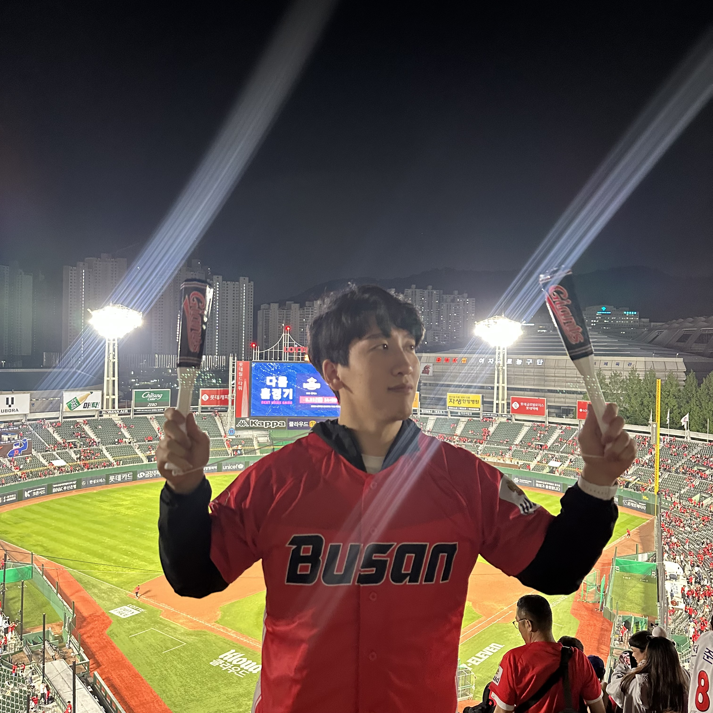
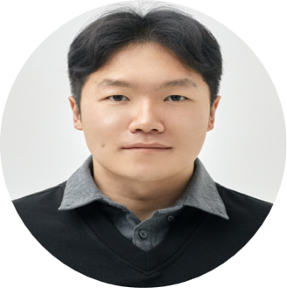


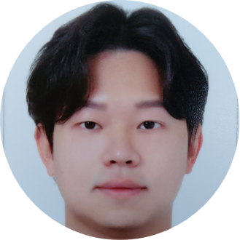
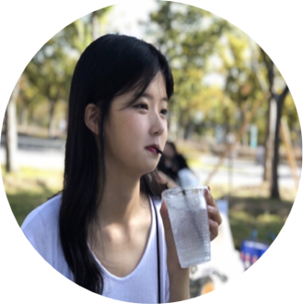
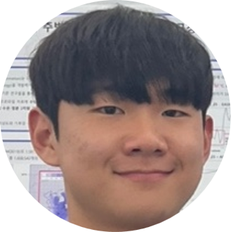
Our Members
Jiho Ko
Changi Lee
Jinwan Joo
Yelim Kim
Graduate student at Pohang University of Science and Technology (POSTECH)’s Climate System Lab.
Graduate student at Chonnam National University’s Climate Science Lab. My major is education, but I interested in climate and atmospheric science.
Student at Kyungpook National University’s Mesoscale Weather Extremes Lab.
Research Assistant at Seoul National University's Weather and Climate Dynamics Lab,
Gunwoo Do
Dasom Ryu
Haedo Baek
Graduate student at Korea Maritime & Ocean University’s Climate Science Lab.
Graduate student at Korea Maritime & Ocean University’s Climate Science Lab.
Graduate student at Chungnam National University`s Ocean Climate Dynamics LAB.

Slide 3
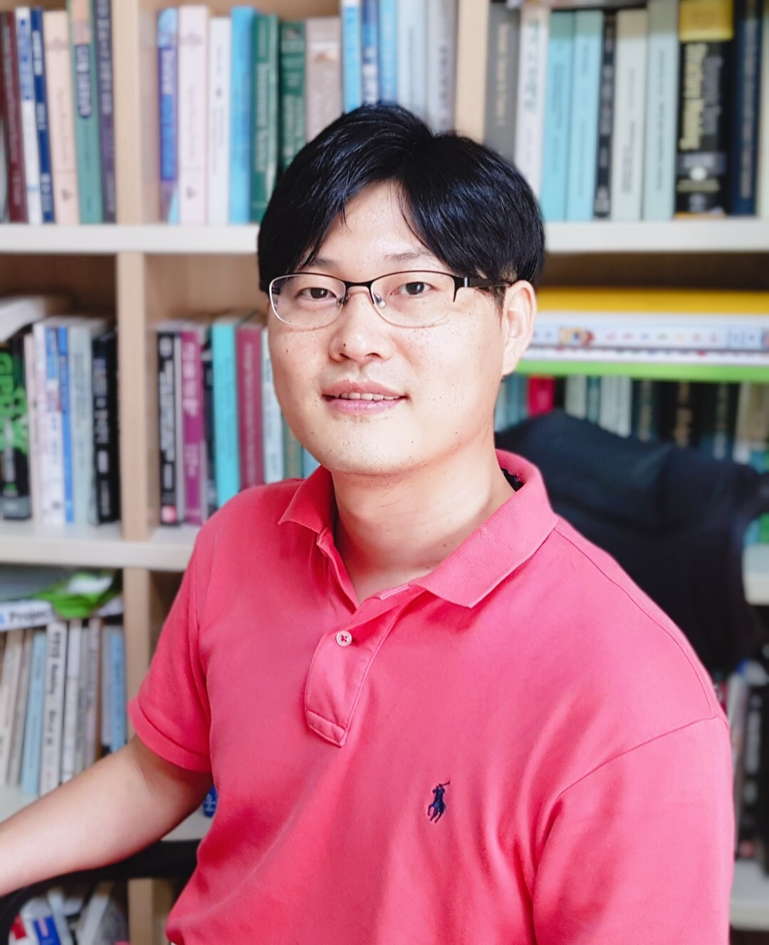
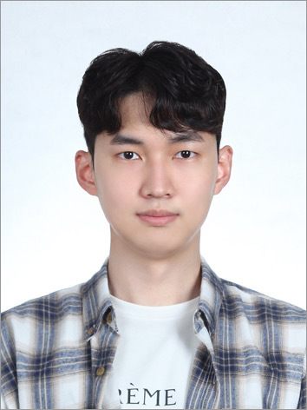

Our Mentors
Hyungon Ryu
Daewon Kim
Song chi-oh
NVIDIA
Machine learning engineer, works in HanwhaSystems/ICT
Machine Learning Engineer
現 Chart studio CEO
前 Linewalks(現 Kakao healthcare)
Aswinkumar
Jeff Adie
Juntao Yang
NVIDIA
NVIDIA
NVIDIA

Slide 4
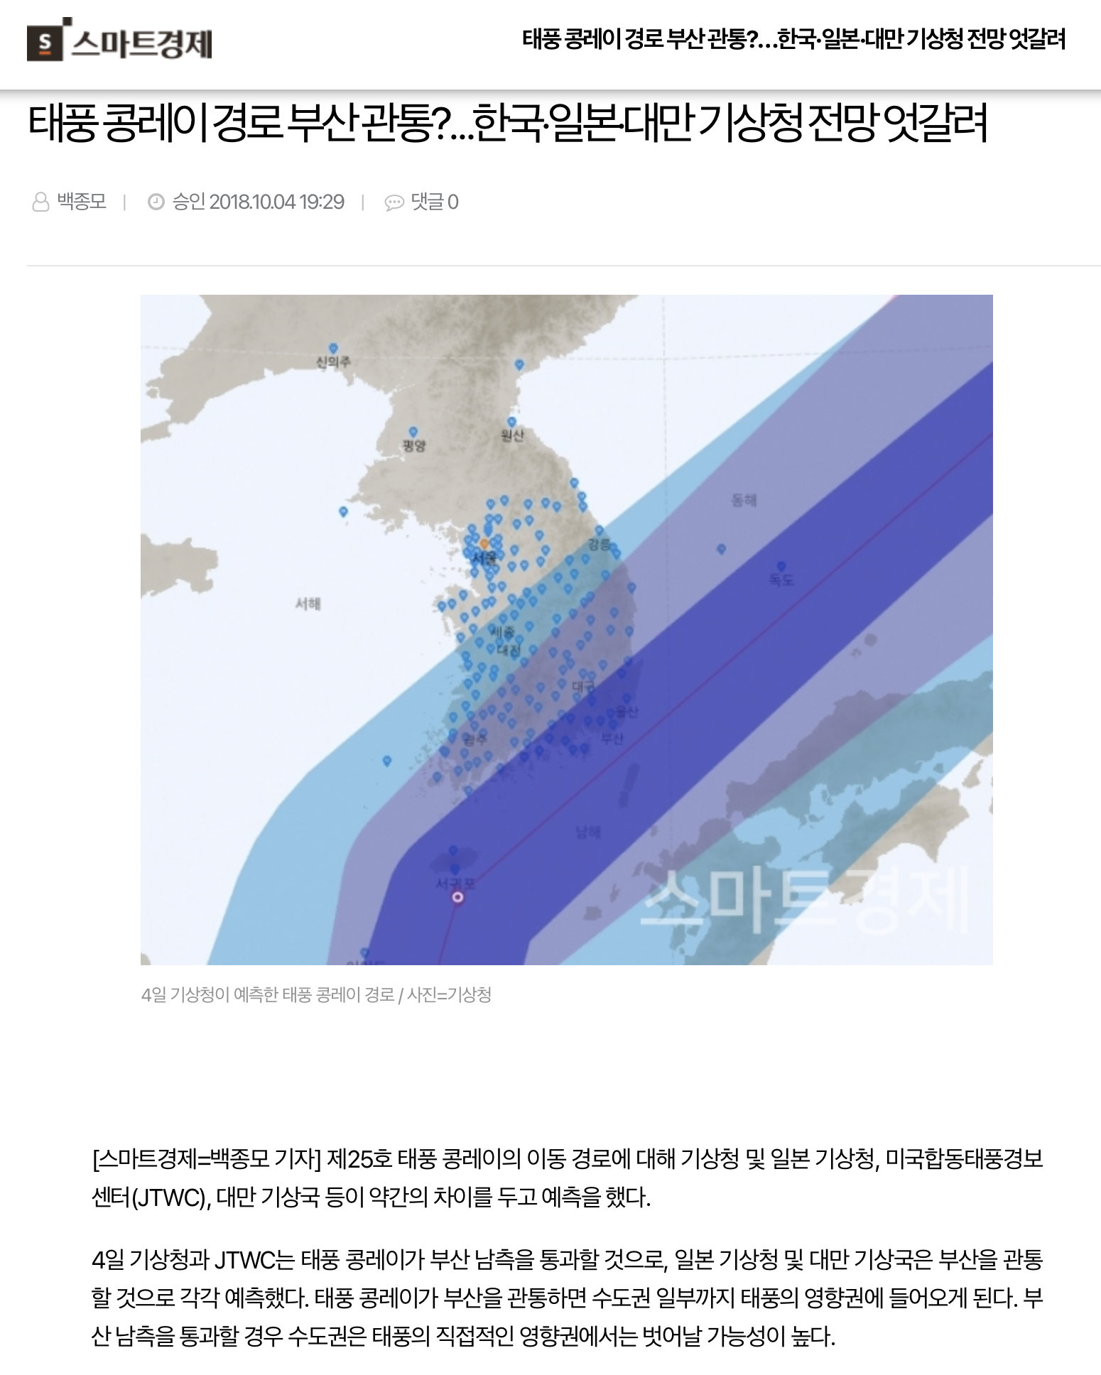
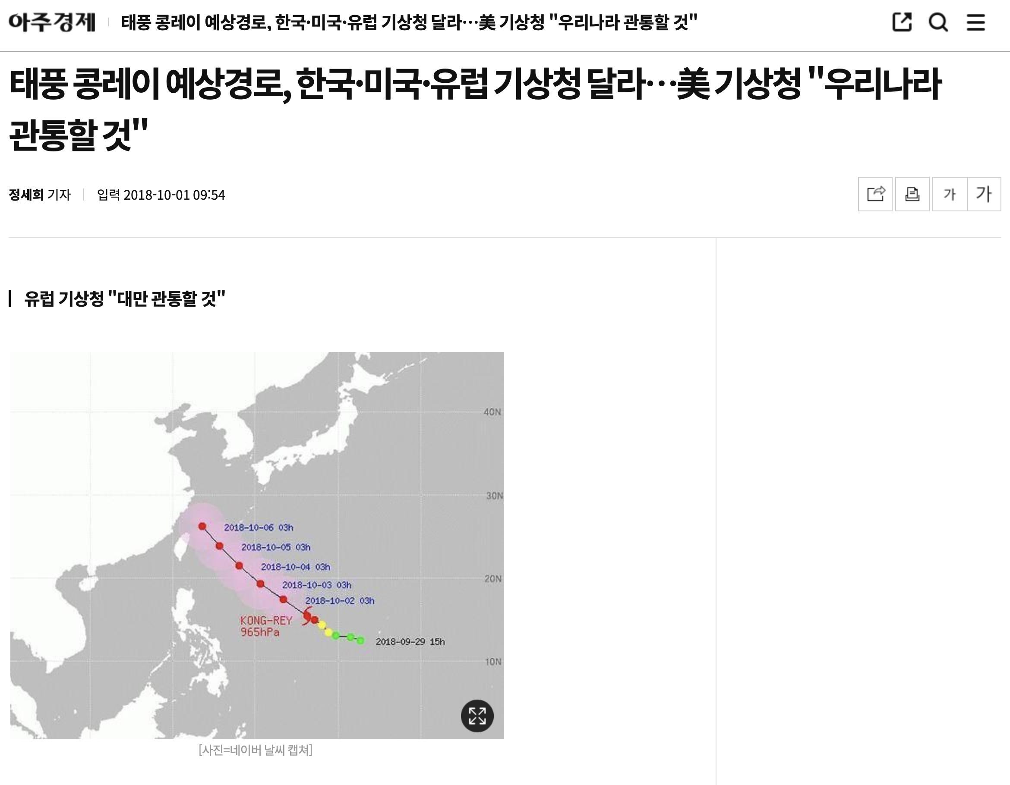
Socially Arisen Issue
Prediction from ECMWF about the projected path of Typhoon Kongrei was inaccurate
ECMWF is the European Centre for Medium-Range Weather Forecasts.
This model is considered the best-performing numerical model.

Slide 5
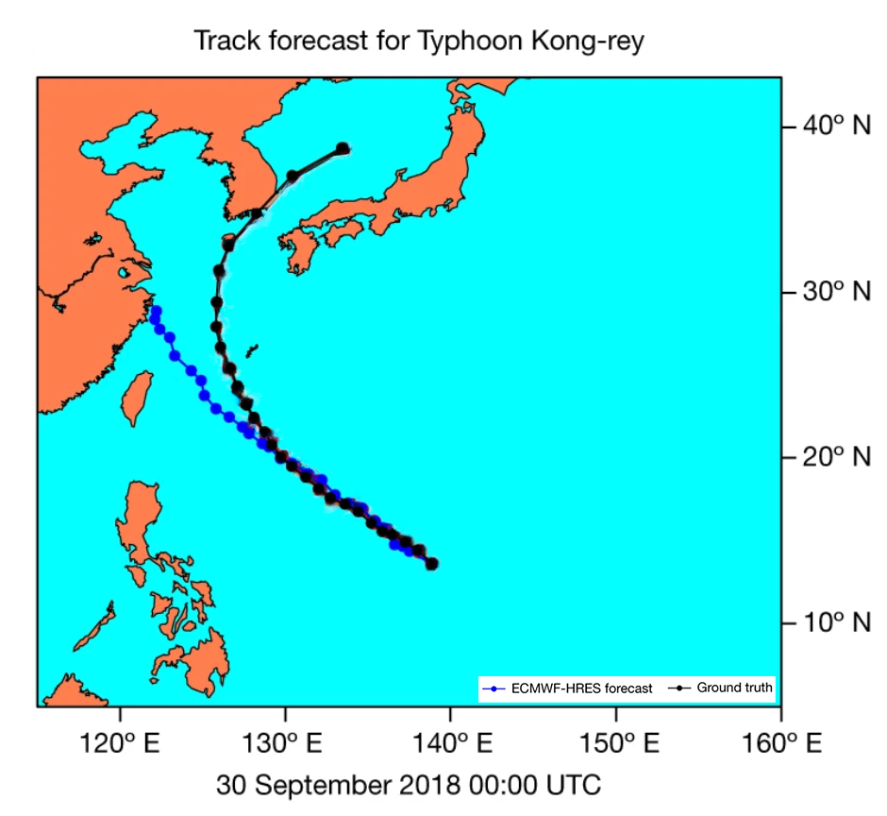
Our Hackathon Topic
Predict Typhoon Kongrei and potentially other typhoons using FCN

Slide 6
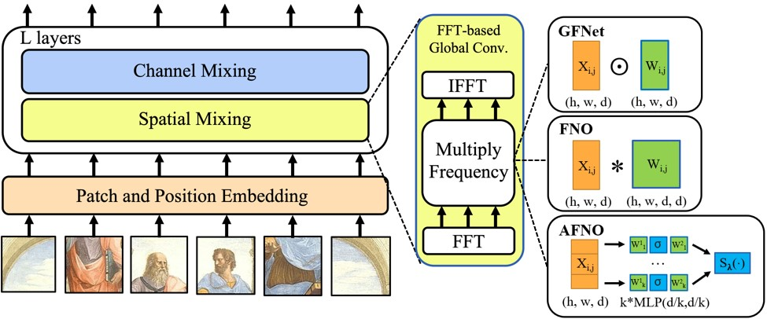
Our Hackathon Topic
FCN model structure——AFNO

Slide 7
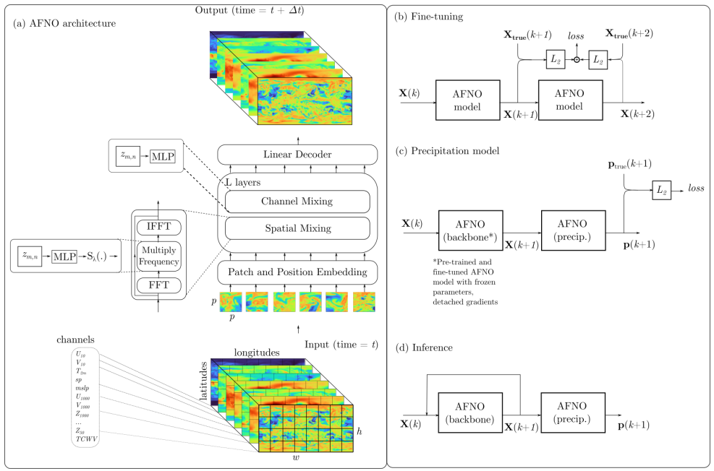
Our Hackathon Topic
FCN model structure

Slide 8
What is Our Goal?
Exploring how we can leverage our background knowledge effectively.
Meteorological research, front-end, deep-learning training
The model is already developed, but training it within the limited time is unfeasible.
How can we improve this situation?
Is there any possibility of applying the model for typhoon forecasts?

Slide 9
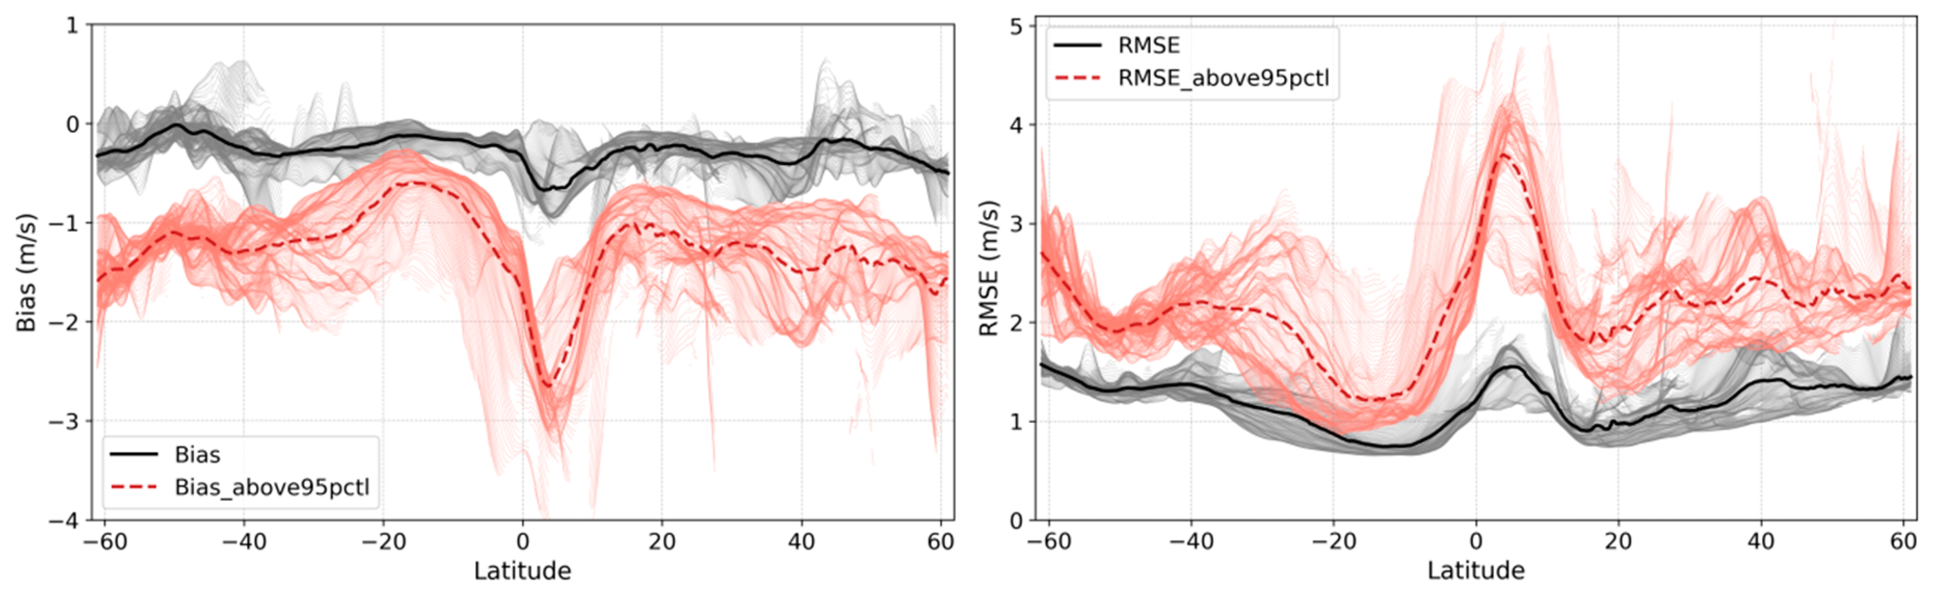
The model is already developed, but training it within the limited time is unfeasible.
How can we improve this situation?
The problems we encountered & proposed solutions
1. Insufficient Data for forecasting
- underestimated for the wind speed values
Campos, R.M.; Gramcianinov, C.B.; de Camargo, R.; da Silva Dias, P.L. Assessment and Calibration of ERA5 Severe Winds in the Atlantic Ocean Using Satellite Data. Remote Sens. 2022, 14, 4918.

Slide 10
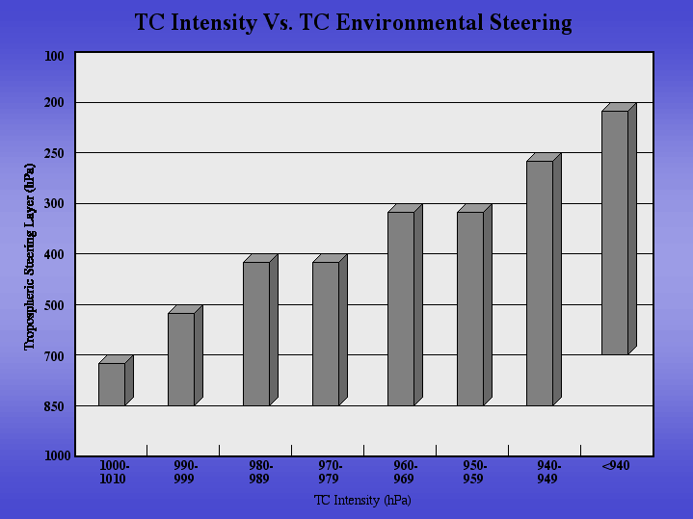
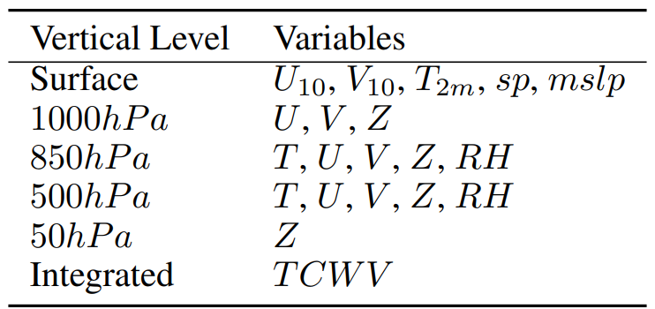
The model is already developed, but training it within the limited time is unfeasible.
How can we improve this situation?
2. limitations of FCN in typhoon forecasting
“FCN is a global data-driven weather forecasting model that provides accurate short to medium range global predictions at 0.25◦ resolution. ”
+ 250hPa T, U, V, Z, RH

Slide 11
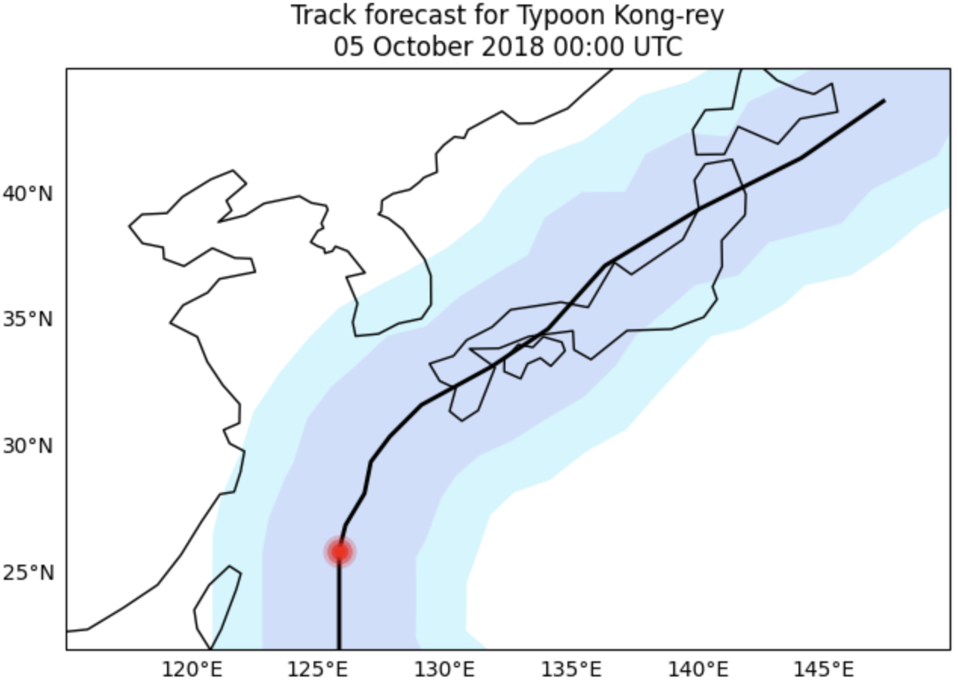

The model is already developed, but training it within the limited time is unfeasible.
How can we improve this situation?
3. Reduce the forecast intervals & increase frequency
“These variables, listed in the table below are sampled from the ERA5 dataset at a temporal resolution of 6 hours.”

Slide 12
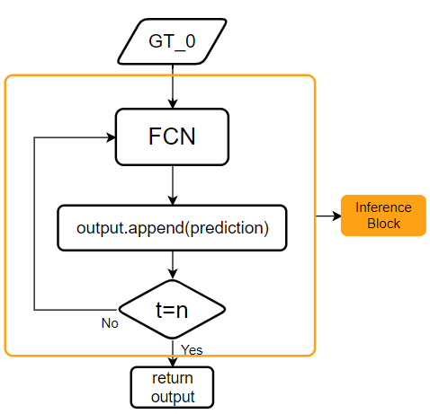
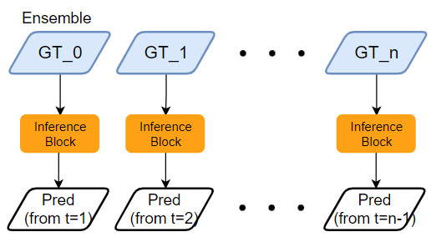
The model is already developed, but training it within the limited time is unfeasible.
How can we improve this situation?
4. Autoregressive Predictions with Ground Truth (GT) Data:
Original
New Structure

Slide 13
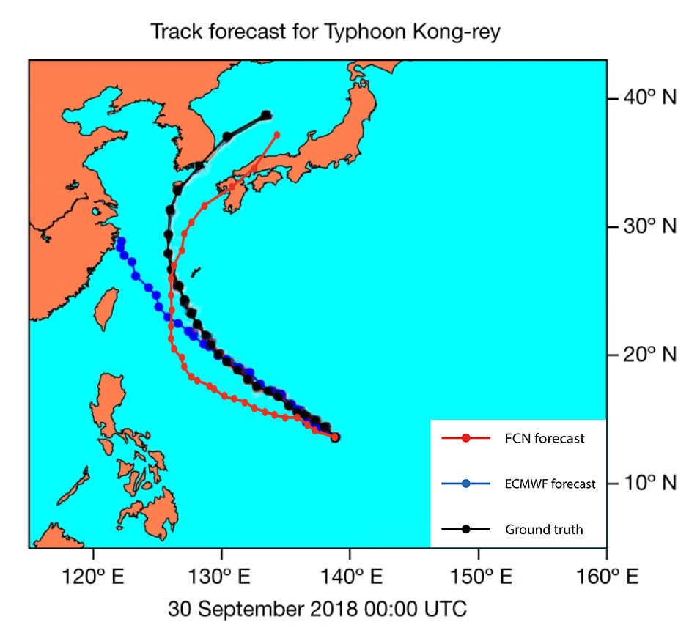
The model is already developed, but training it within the limited time is unfeasible.
How can we improve this situation?
4. Autoregressive Predictions with Ground Truth (GT) Data:

Slide 14
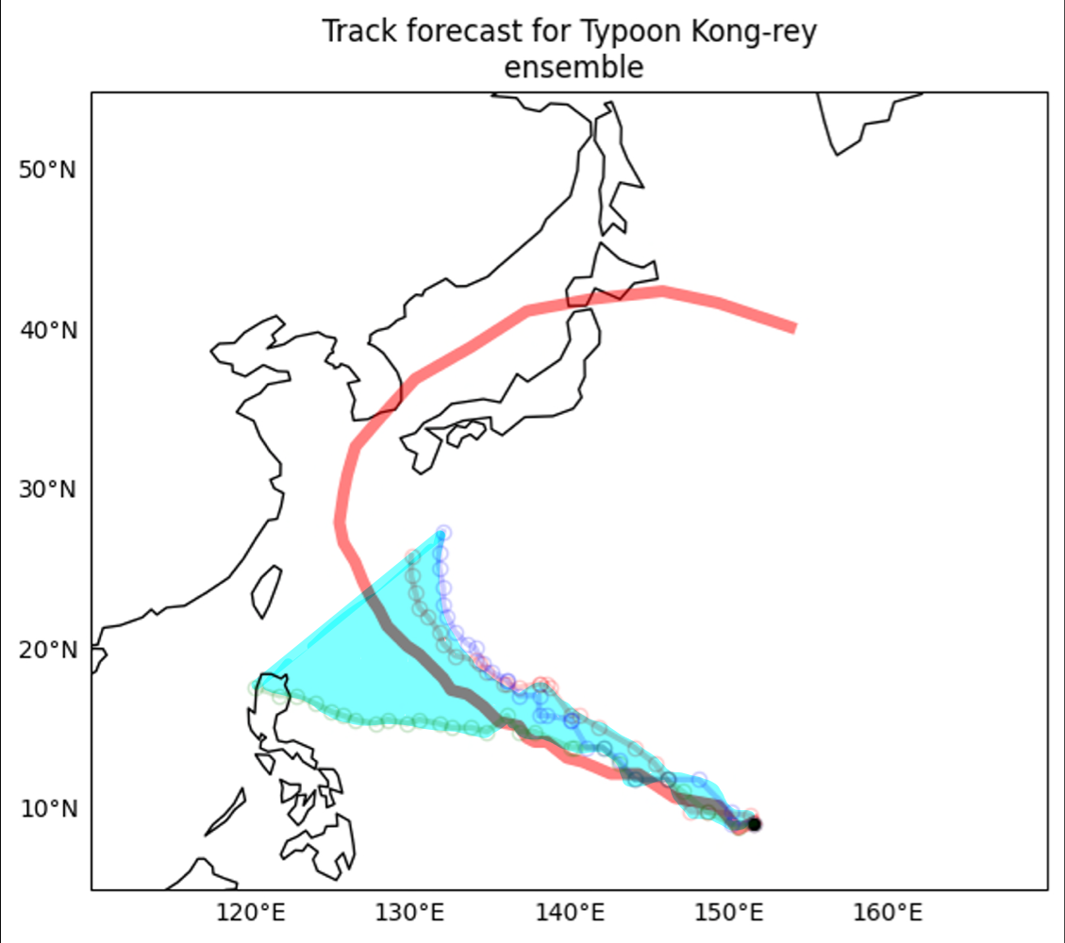
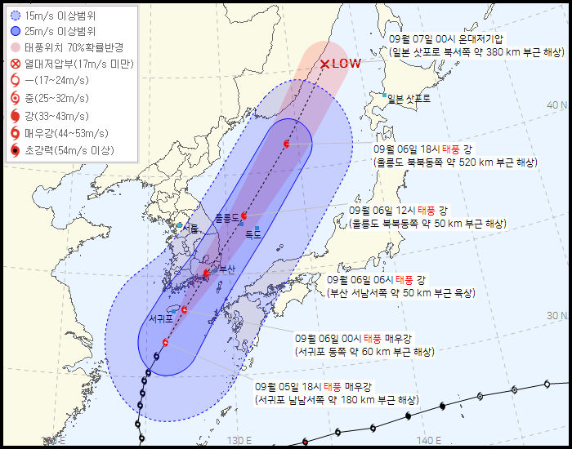
The model is already developed, but training it within the limited time is unfeasible.
How can we improve this situation?
4. Autoregressive Predictions with Ground Truth (GT) Data:

Slide 15
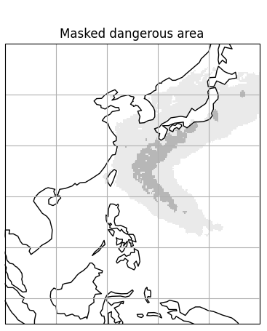
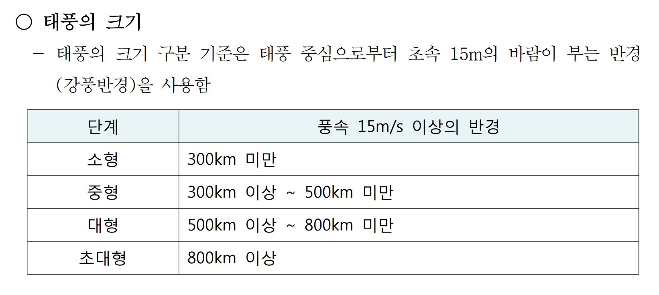
Considering the possibility of applying the model for typhoon forecasts.
The problems we encountered & proposed solutions
1. Selecting the typhoon influence radius
From Typhoon White Book

Slide 16
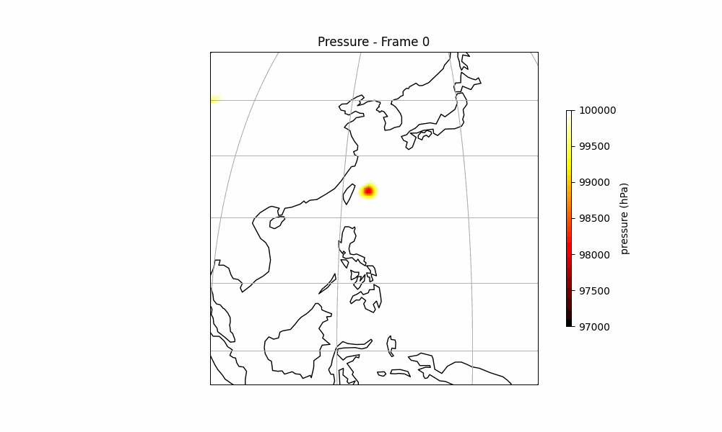
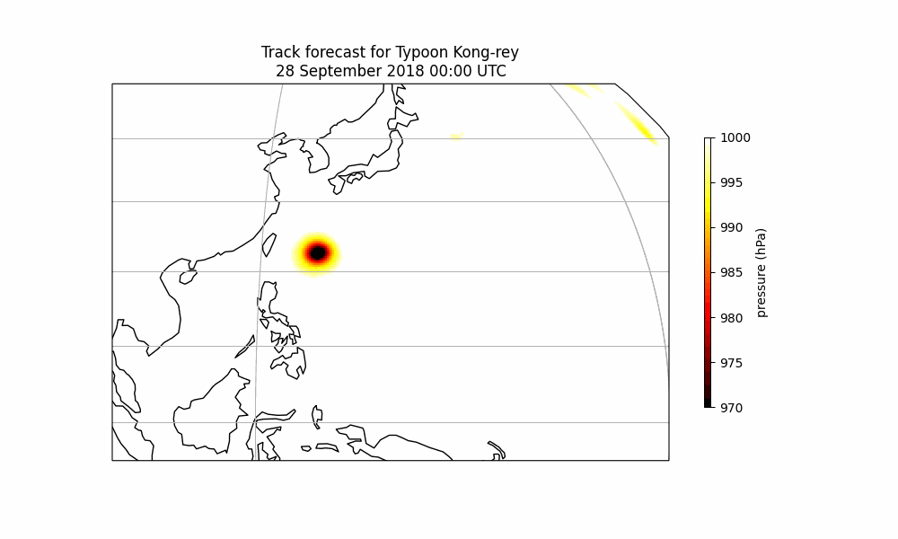
Considering the possibility of applying the model for typhoon forecasts.
2. Processing multiple typhoons

Slide 17
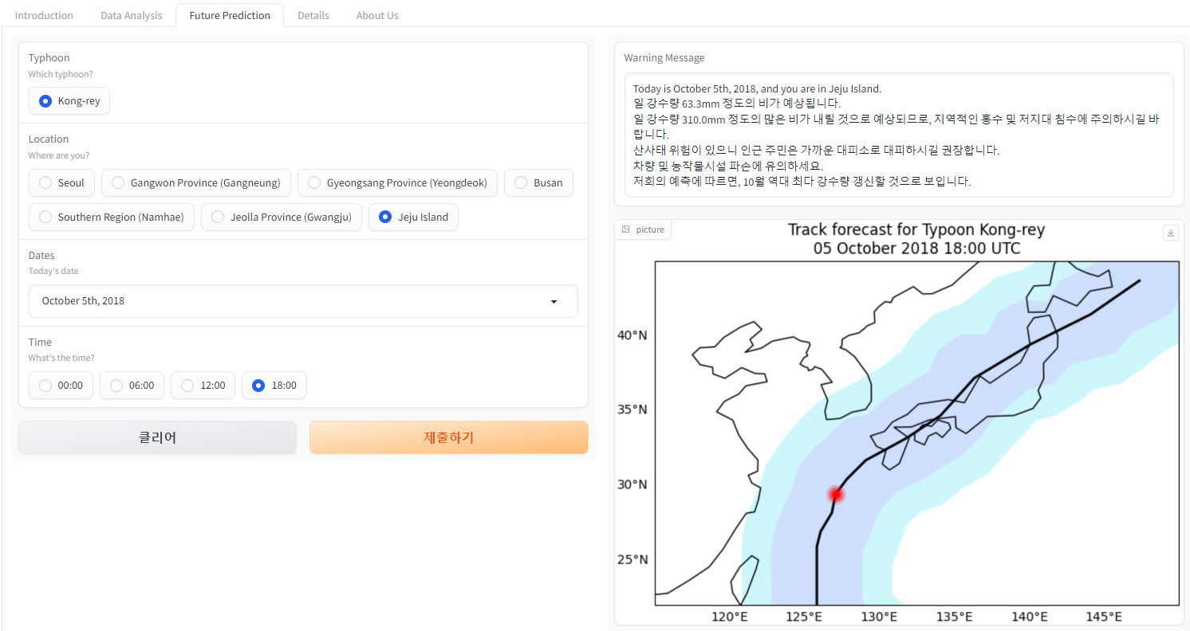
Considering the possibility of applying the model for typhoon forecasts.
3. How to make users use it?

Slide 18
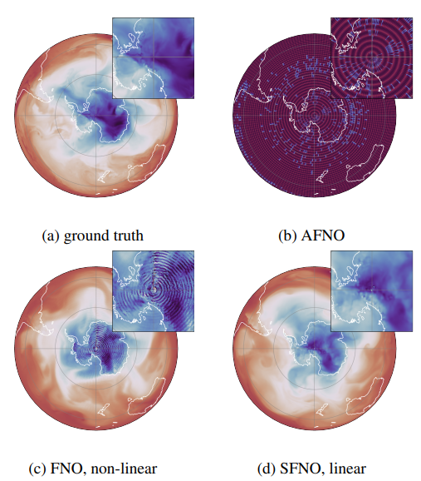
Insights from the Hackathon
Potential research topics for future exploration.
1. AFNO -> SFNO
Bonev, Boris et al. “Spherical Fourier Neural Operators: Learning Stable Dynamics on the Sphere.” ArXiv abs/2306.03838 (2023): n. pag.

Slide 19
Insights from the Hackathon
Potential research topics for future exploration.
2. Change variables
+ 250hPa T, U, V, Z, RH

Slide 20
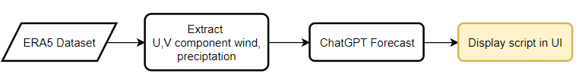
Insights from the Hackathon
Potential research topics for future exploration.
3. enhance UI for real-case

Slide 21
Insights from the Hackathon
Ideas on how we can apply the knowledge gained in our respective labs.
현재 딥러닝 모델들의
성능향상을 위한 언급된 개선점
한파 발생 예측에서는 태풍보다
더 나은 예측 성능을 보일 것으로
생각이 들고, 적용해보고 싶다
FCN의 inference 코드를 계속 수정하며 돌리면서 했던 경험을 바탕으로 딥러닝 모델을 활용할 때 어떤식으로 코드를 구성해서 작동시키면 될지에 로직에 대해 이해하게 된 것을 적용시켜 직접 모델을 구현하여 실행하여 현재 도메인에 적용 시키면 될 것이라 생각이 들었습니다.
기후변화 시나리오를 이용한 미래
기후에서의 태풍 진로 및 강도 예측
자연 재해로 인해 발생하는 사회
경제적 피해 예측
UI for Real-case

Slide 22
Insights from the Hackathon
“One Sentence”
“논문 용 코드”에 대해서 알고
싶지 않았지만 알게 되었다.
조교님 목소리 좀 크게 해주세요ㅎ.ㅎ
신경식 강사님 사진 같이 찍어도 되나요? 아니면 싸인이라도...
연구실을 나와서 좋았다..
오프라인 해커톤 진행 기간 동안
랩미팅 준비하는 기분이었습니다...ㅠ
대전은 노잼도시가 아니다
배고플 때가 없었다
너무 많이 먹었다

Slide 23
THANK YOU!
Typhoon Sensei

Slide 24
Our jobs in the project
UI 구성 및 개발,
PPT 및 전체 총괄
논문 자료 찾기, 시각화
데이터 분석, 시각화
시각화 개선
inference.py수정, 앙상블 개선
태풍 영향 반경 시각화,
UI 첫페이지
UI Detail 페이지,
스타팅 포인트 3D 시각화

